Slide 1
Motion Prediction Using Data Driven Approach
Seminar Electromobility SS 2022
Jainam Chetankumar Shah (423002)
Varad Vaibhav Avchat (422821)
Pinak Rameshbhai Savaliya (422808)
Technical University Of Kaiserslautern

Slide 2
Overview
Introduction
Need for an Autonomous Vehicle.
Neural Network-Based models
Different types of Neural Network based models.
Principle of Motion Prediction.
Types of Motion Prediction Methods.
Experimental Analysis
Conclusion
Method Used To Train The Neural Network
FCN Keras Model and LSTM Model
Dataset used for seminar
Project Description
Jainam Shah, Varad Avchat, Pinak Savaliya
TU Kaiserslautern
Seminar Electromobility | SS 22
Motion Prediction for Automated Vehicles

Slide 3
Project Goal
Objective is to develop a Motion prediction algorithm for automated vehicles for minimizing the prediction error:
The performance of the predictions will be evaluated based on:
Average Displacement Error: Average Euclidean distance between the position prediction and ground truth.
Average Final Displacement Error: Average Euclidean distance between the position prediction and ground truth of the last prediction step.
Average Absolute Heading Error: Average absolute deviation of the heading.
Jainam Shah, Varad Avchat, Pinak Savaliya
TU Kaiserslautern
Seminar Electromobility | SS 22
Motion Prediction for Automated Vehicles

Slide 4
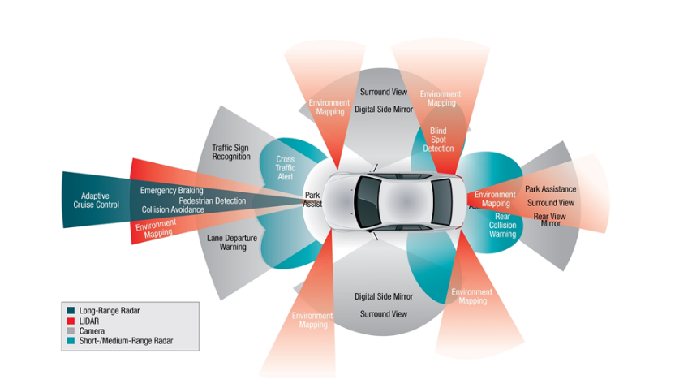
Autonomous Vehicle
Also known as a self-driving car, an autonomous car, driver-less car, or robotic car.
A car incorporating vehicular automation, that is, a ground vehicle that is capable of sensing its environment and moving safely with little or no human input.
Jainam Shah, Varad Avchat, Pinak Savaliya
TU Kaiserslautern
Seminar Electromobility | SS 22
Motion Prediction for Automated Vehicles

Slide 5
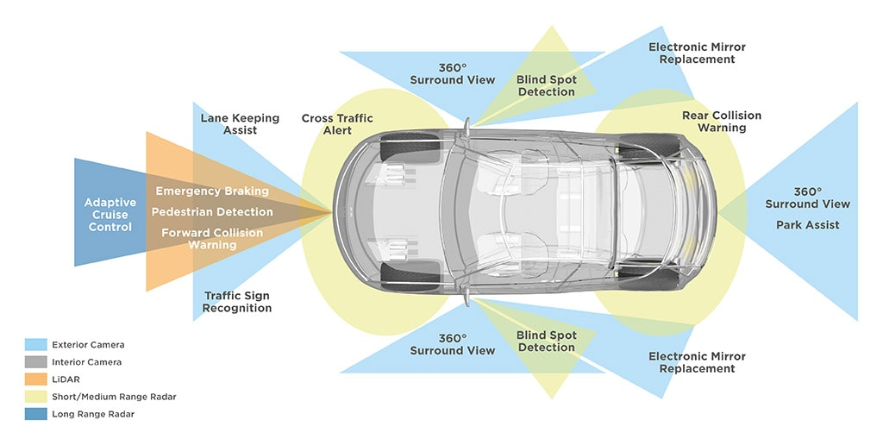
Features of Automated Vehicles
Autonomous driving has attracted the attention of multidisciplinary research. Features of the autonomous vehicle are the following:
Avoiding accidents
Improving safety
Contributing to the optimization of traffic flow
Reducing CO2 emissions.
Enhancing the mobility of elderly people and unconfident drivers.
Jainam Shah, Varad Avchat, Pinak Savaliya
TU Kaiserslautern
Seminar Electromobility | SS 22
Motion Prediction for Automated Vehicles

Slide 6
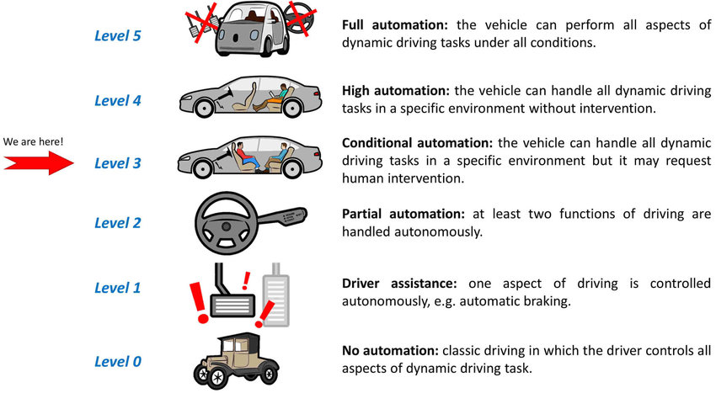
Levels of Automation
Jainam Shah, Varad Avchat, Pinak Savaliya
TU Kaiserslautern
Seminar Electromobility | SS 22
Motion Prediction for Automated Vehicles

Slide 7
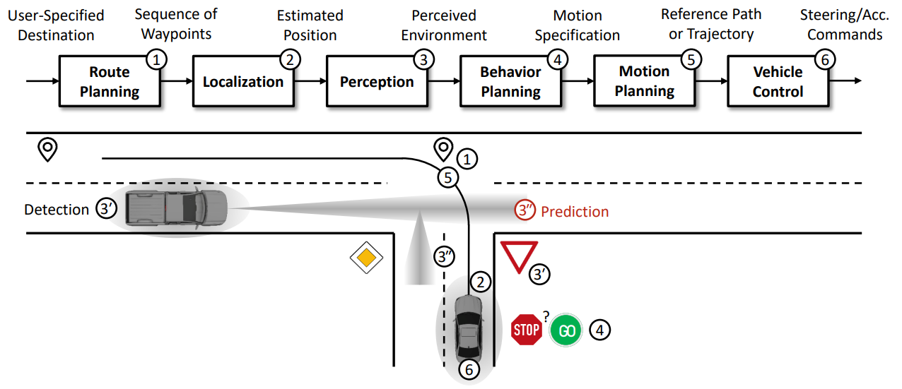
Motion Prediction in Automated Vehicles
Jainam Shah, Varad Avchat, Pinak Savaliya
TU Kaiserslautern
Seminar Electromobility | SS 22
Motion Prediction for Automated Vehicles

Slide 8
Motion Prediction
The sensors in self-driving cars enable them to perform tasks like image classification, object detection, segmentation, and localization.
With various forms of data representation, the car can make predictions of the object around it.
A deep learning algorithm can model such information (images and cloud data points from LiDARs and RADARs) during training.
The same model, but during inference, can help the car to prepare for all the possible moves which involve braking, halting, slowing down, changing lanes, and so on.
The role of deep learning is to interpret complex vision tasks, localize itself in the environment, enhance perception, and actuate kinematic maneuvers in self-driving cars. This ensures road safety and easy commute as well.
Jainam Shah, Varad Avchat, Pinak Savaliya
TU Kaiserslautern
Seminar Electromobility | SS 22
Motion Prediction for Automated Vehicles

Slide 9
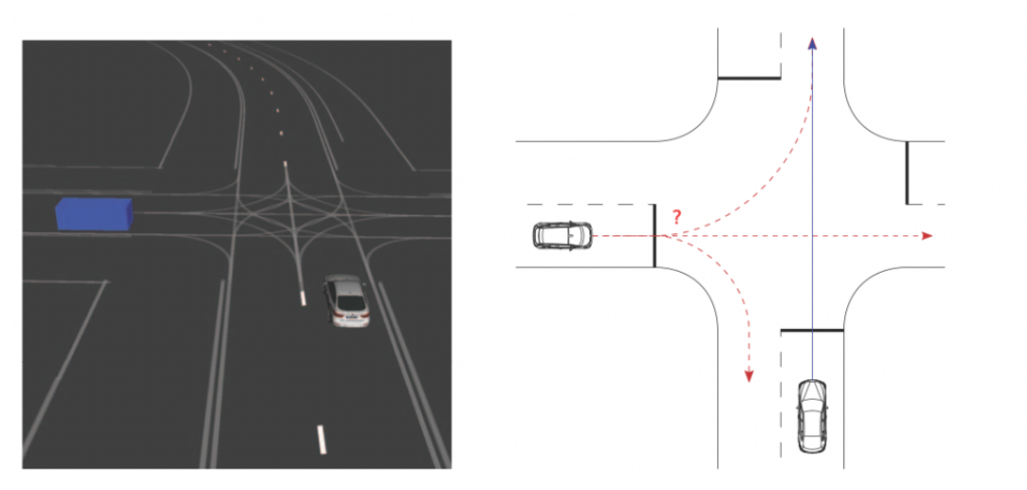
Motion Prediction
Decision Making
Decision-making is vital in self-driving cars.
They need a system that’s dynamic and precise in an uncertain environment.
It needs to take into account that not all sensor readings will be true and that humans can make unpredictable choices while driving.
These things can’t be measured directly. Even if we could measure them, we can’t predict them with good accuracy.
Jainam Shah, Varad Avchat, Pinak Savaliya
TU Kaiserslautern
Seminar Electromobility | SS 22
Motion Prediction for Automated Vehicles

Slide 10
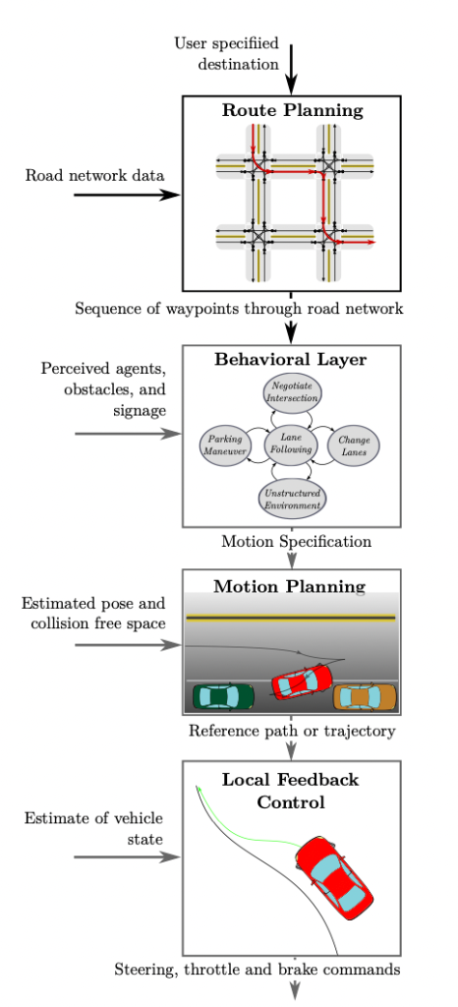
Motion Prediction
Components of Decision Making:
Path or Route Planning
Behavior Arbitration
Motion Planning
Vehicle Control
Jainam Shah, Varad Avchat, Pinak Savaliya
TU Kaiserslautern
Seminar Electromobility | SS 22
Motion Prediction for Automated Vehicles

Slide 11
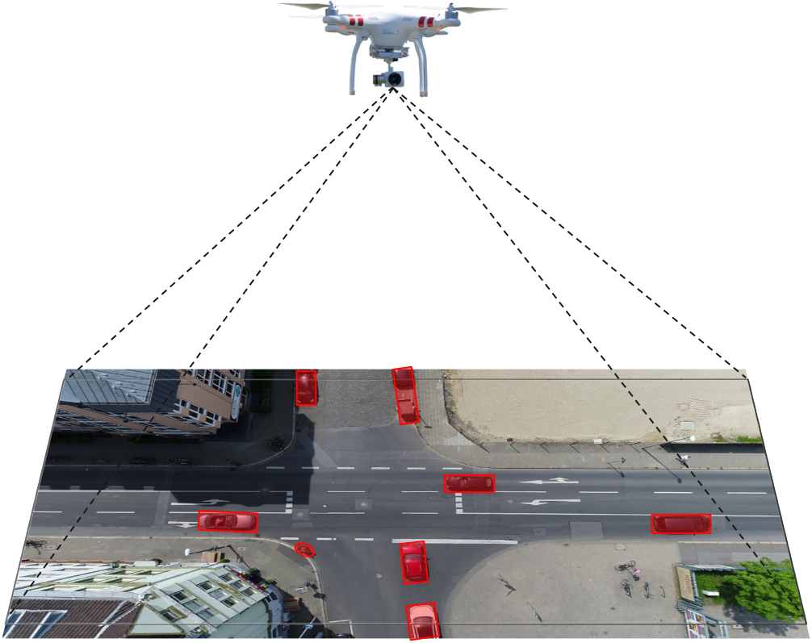
Dataset
The inD dataset is a new dataset of naturalistic vehicle trajectories recorded at German intersections.
The dataset features four different recording locations.
Different intersection types.
We are considering only location id 2 from the dataset.
Jainam Shah, Varad Avchat, Pinak Savaliya
TU Kaiserslautern
Seminar Electromobility | SS 22
Motion Prediction for Automated Vehicles

Slide 12
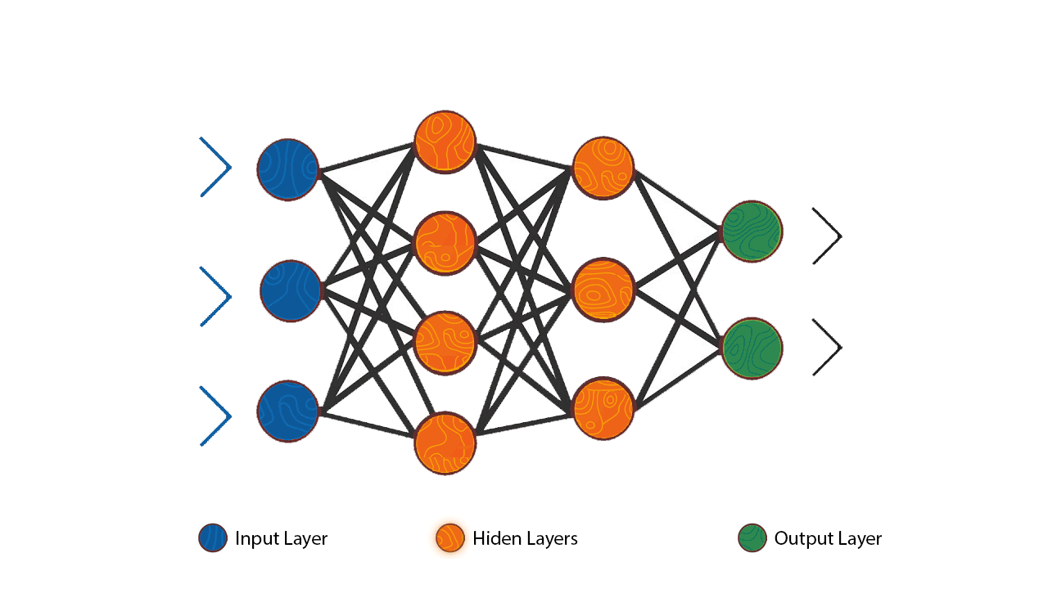
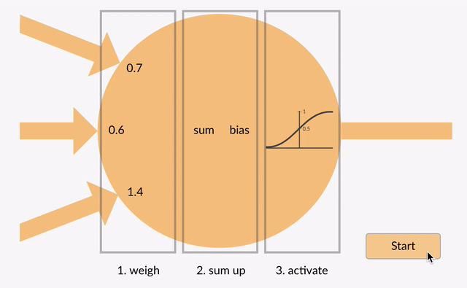
Artificial Neural Network
Artificial Neural Network
a group of multiple perceptrons/ neurons at each layer.
also known as a Feed-Forward Neural network because inputs are processed only in the forward direction.
capable of learning any nonlinear function.
networks are popularly known as Universal Function Approximators.
Jainam Shah, Varad Avchat, Pinak Savaliya
TU Kaiserslautern
Seminar Electromobility | SS 22
Motion Prediction for Automated Vehicles

Slide 13

Recurrent Neural Network
RNN has a recurrent connection to the hidden state.
looping constraint ensures that sequential information is captured in the input data.
RNN captures the sequential information present in the input data i.e. dependency between the words in the text while making predictions.
Jainam Shah, Varad Avchat, Pinak Savaliya
TU Kaiserslautern
Seminar Electromobility | SS 22
Motion Prediction for Automated Vehicles

Slide 14
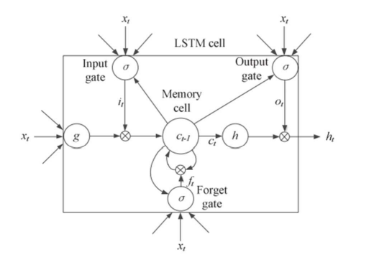
Long-Term-Short Memory
LSTM model has the parameter called gate: input gate, output gate, forgot gate.
By these parameters, the LSTM network regulates the status of cells and modifies or adds information to them.
The input gate receives input from the latest iteration's output of the LSTM neural network cell, which regulates the volume of input to the memory cell.
By deciding when to forget the output, the forget gate may choose the ideal time delay for the input sequence.
The LSTM neural network unit, which regulates the output's strength, receives all the computed results and outputs them to the output gate.
Jainam Shah, Varad Avchat, Pinak Savaliya
TU Kaiserslautern
Seminar Electromobility | SS 22
Motion Prediction for Automated Vehicles

Slide 15

Convolutional Neural Network
CNN learns the filters automatically without mentioning them explicitly.
These filters help in extracting the right and relevant features from the input data.
Jainam Shah, Varad Avchat, Pinak Savaliya
TU Kaiserslautern
Seminar Electromobility | SS 22
Motion Prediction for Automated Vehicles

Slide 16
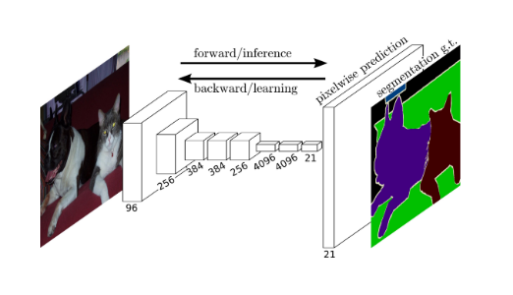
Fully Convolutional Network
FCNs, or Fully Convolutional Networks, are a form of architecture that is primarily used for semantic segmentation. Convolution, pooling, and upsampling are the only locally linked layers they use.
FCN is a network that does not contain any “Dense” layers (as in traditional CNNs) instead it contains 1x1 convolutions that perform the task of fully connected layers (Dense layers).
FCN can handle a wide range of image sizes since all connections are local.
Jainam Shah, Varad Avchat, Pinak Savaliya
TU Kaiserslautern
Seminar Electromobility | SS 22
Motion Prediction for Automated Vehicles

Slide 17
Results
We have used two different approaches to train the neural network models.
Firstly we have used the FCN Keras Model in that we have trained the different location Ids and tested the data on 28.
The result was that AHE was 8.136 m, FDE was 8.967 m, and AHE is 9.96 degrees.
After that we trained the neural network on the LSTM model with the different parameters used from the FCN model.
We have changed the activation parameters from ‘tanh’ to ‘relu’ and also have reduced the number of hidden layers.
Apart from that we have selected a number of neurons in the multiplication of power of two for optimal result.
Jainam Shah, Varad Avchat, Pinak Savaliya
TU Kaiserslautern
Seminar Electromobility | SS 22
Motion Prediction for Automated Vehicles

Slide 18
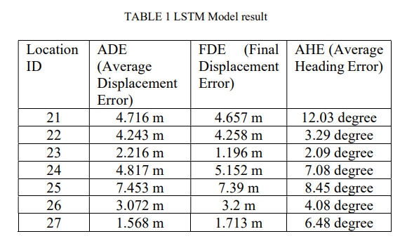
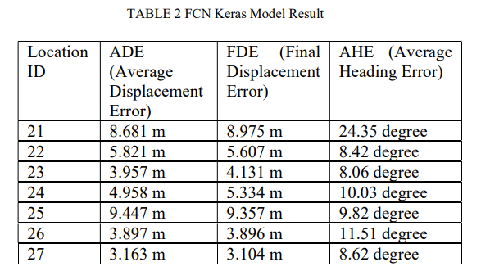
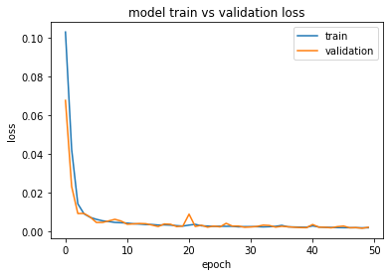
Results
From the above two tables comparison can be made for the FCN Keras model and the LSTM model. It can be shown from the result LSTM model has provided optimal output compared to the FCN Keras model.
It was trained on Location ID 27. AHE was 1.568 m, FDE was 1.713 m and AHE was 6.48 degrees.
Jainam Shah, Varad Avchat, Pinak Savaliya
TU Kaiserslautern
Seminar Electromobility | SS 22
Motion Prediction for Automated Vehicles

Slide 19
Conclusion
From the results obtained for FCN and LSTM, we conclude that the average displacement error obtained is less for the LSTM model is less as compared to the FCN Keras model.
An LSTM is designed to work differently than a CNN because an LSTM is usually used to process and make predictions given sequences of data.
Jainam Shah, Varad Avchat, Pinak Savaliya
TU Kaiserslautern
Seminar Electromobility | SS 22
Motion Prediction for Automated Vehicles

Slide 20
THANK YOU

